Slide 1






Impedanz
Matrix Magic in Circuit Analysis
How Kirchhoff’s Laws Transform into Matrix Equations

Slide 2

5leha 3la Allah
Seif Haythem
Abdelrahman Gomaa
Abdelrahman Essmat
Ahmed Zaytoon
Hesham Elkateb

Slide 3
Why Linear Algebra for Circuits Analysis?
Problem

Slide 4
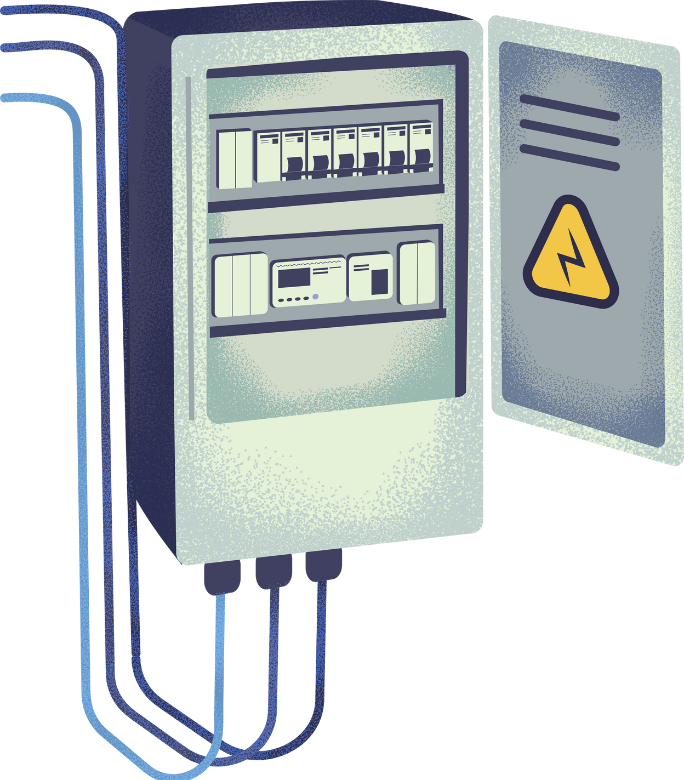
Problem
Manual KCL/KVL calculations are error-prone and tedious for complex circuits.

Slide 5

Planar vs. Non-Planar Circuits
Planar Circuits
Non-Planar Circuits
i
No wire crossings
i
Crossings unavoidable
Admittance Matrix (Y) is sparse
ii
Admittance may have dense off-diagonals
ii
Mesh current method (KVL)
Nodal Analysis method (KCL)
Requires advanced graph theory:
Topological Sorting
Modified Nodal Analysis (MNA)
iii
iii

Slide 6

Tackled problems
Bridge Circuit
Multi-Loop Circuit with Dependent Sources
Non-Planar Circuit
Circuit complexity: 5 resistors with cross-connection
Challenge: non-parallel/series combinations.
Equations needed: 3 KCL , 2 KVL
Circuit complexity: 4 loops + current-controlled voltage source
Challenge: Coupled equations due to dependent sources
Special Case: Requires adding constraint equations
Circuit complexity: Resistors forming tetrahedral connections
Challenge: Cannot be drawn without cross-overs
Solution: Requires full nodal analysis

Slide 7

Multi-Loop Circuits with independent Sources

Slide 8
1.circuit complexity

Slide 9
circuit complexity
Topology:
Four independent loops
Key Challenge:
Coupled equations due to:
Interdependent loop currents
Additional constraints from dependent sources

Slide 10
2.Why It is Hard

Slide 11

Why It is Hard
Dependent Sources:
Introduce variables tied to other branch currents/voltages
Example: CCVS adds term like V = βIₓ (β = gain, Iₓ = control current)
Matrix Fill-In:
Breaks sparsity patterns → Denser system matrix

Slide 12
3.Visual

Slide 13
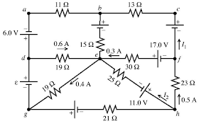
Visual

Slide 14
Why Linear Algebra for Circuits Analysis?
Problem
Solution

Slide 15

Our Solution !
Graph Theory + Linear Algebra = Automated solver
Circuits are graphs → Matrices naturally model them

Slide 16



The process
Circuit
Graph
Matrix Y
LU Solver

Slide 17

Circuits as Graphs
Nodes = Junctions
(currents split/merge)
Edges = Components (R , L , C)
(Voltage sources).
Representation:
Adjacency matrix

Slide 18
From Kirchhoff to Matrices
Matrix Representations
Systems of Linear Equations
Matrix Properties
KCL → YV = I
Solution: V = Y⁻¹I
(LU decomposition in code)
Admittance Matrix (Y)
Current Vector
Voltage Vector
Rank-nullity theorem
Sparsity
Symmetry

Slide 19
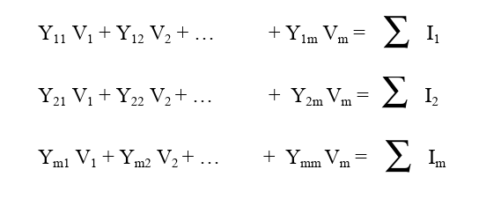

Building the
system
using
Nodal Analysis
Method:
Apply Kirchhoff's Current Law (KCL) at each node
System of equations
m = n - 1
V1, V2 and Vm are voltages from nodes 1, 2 and so on ..., n
with respect to the reference node.
∑ Ix is the algebraic sum of current sources at node x.

Slide 20
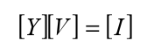
Admittance Matrix (Y)
Current Vector (I)
Voltage Vector (V)
Diagonal: Sum of admittances at each node.
Matrix form
Off-diagonal: Negative admittance
between connected nodes.
Sum of current sources entering each node
Unknown node voltages:
Reference node (GND): Set to 0V

Slide 21
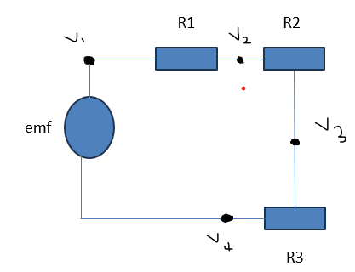
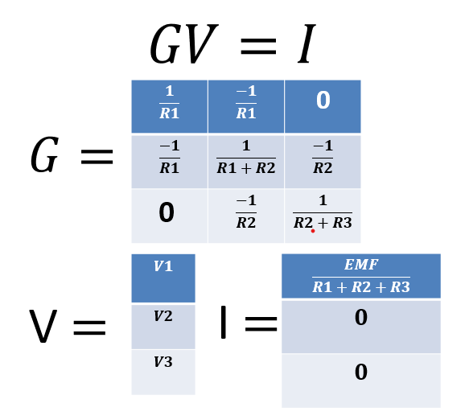
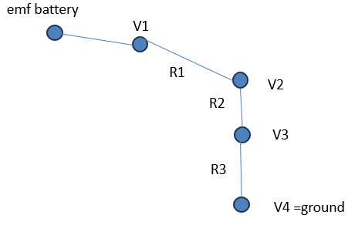
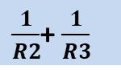
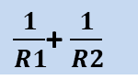
Process
Circuit
Graph
Matrices
$\frac{1}{R1}$+ $\frac{1}{R2}$
$\frac{1}{R2}$+ $\frac{1}{R3}$

Slide 22
Why LU Decomposition?
Mathematical Process
Factorize: Y = LU
L: Lower triangular U: Upper triangular
Equation : LU V = I
2. Solve:
let Z= UV
Forward substitution: L Z = I (for Z)
Backward substitution: UV = Z (for V )
Advantages:
Exact solution (no iterative error)
Reusable factorization for multiple RHS vectors
Stable with partial pivoting

Slide 23
EXTENDING TO AC ANALYSIS
IMPACT
SOLVER WORKS UNCHANGED:
V = SCIPY.LINALG.SOLVE(G_COMPLEX, I_COMPLEX)
MATRIX ENTRY (Y)
RESISTOR 1/R
INDUCTOR -J / (( 2 PI F ) L)
CAPACITOR J 2 PI F C
1. WHAT WE ADDED
COMPLEX IMPEDANCE HANDLING
PHASE-AWARE RESULTS
2. IMPORTANCE
REAL-WORLD RELEVANCE
AC DOMINATES PRACTICAL
CIRCUITS (AUDIO, POWER, RF)

Slide 24
SNIPPETS OF IMPEDANZ

Slide 25
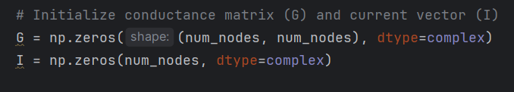
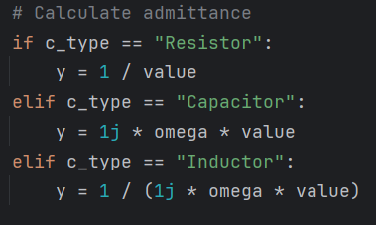
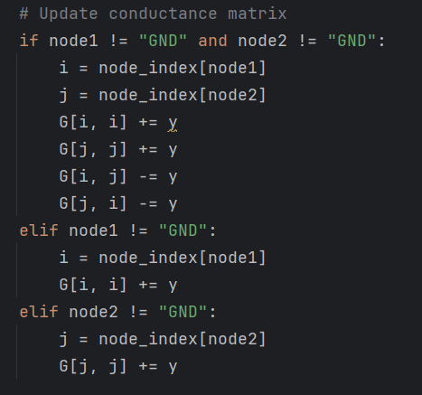
Explore the Code !
Matrix Construction:
AC Support:

Slide 26

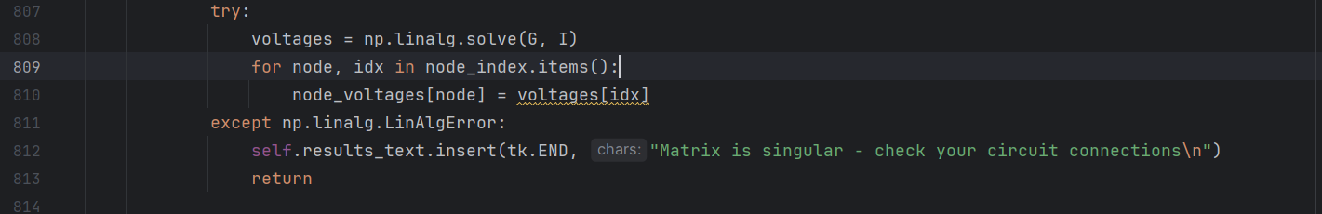
The Role of LU in Our System
FUNCITONS
Efficiency:
Factorization: O(n3) (done once)
Substitutions: O(n2) (fast for multiple b )
analyze_circuit(self, omega)
Builds the admittance matrix Y
Builds current vector I
np.linalg.solve(Y, I)
Solves the linear system using LU decomposition internally
SNIPPET:

Slide 27
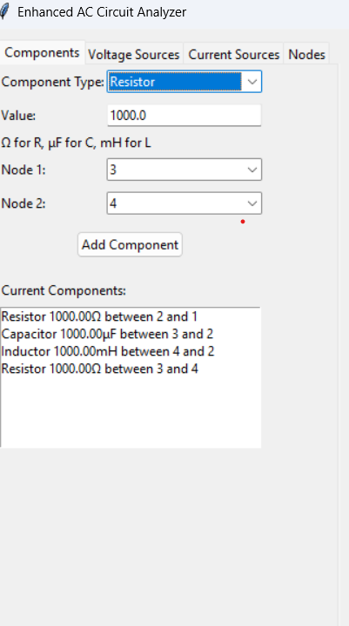
GUI Features
SLIDE CONTENT:
COMPONENT SELECTION
RESISTOR / CAPACITOR / INDUCTOR
SOURCE CONFIGURATION
SINE + PHASE, FREQUENCY, VOLTAGE
NODE MANAGEMENT
ADD/REMOVE CUSTOM NODES
AUTOMATIC GROUNDING
INSTANT RESULTS
IMPEDANCE, VOLTAGES, CURRENTS
(MAGNITUDE & PHASE)

Slide 28
Value of Impedanz
Eliminates human errors in KCL/KVL equations
Visualizes circuit behavior instantly (voltages + currents)
Handles series, parallel, AC/DC, and tricky circuits

Slide 29
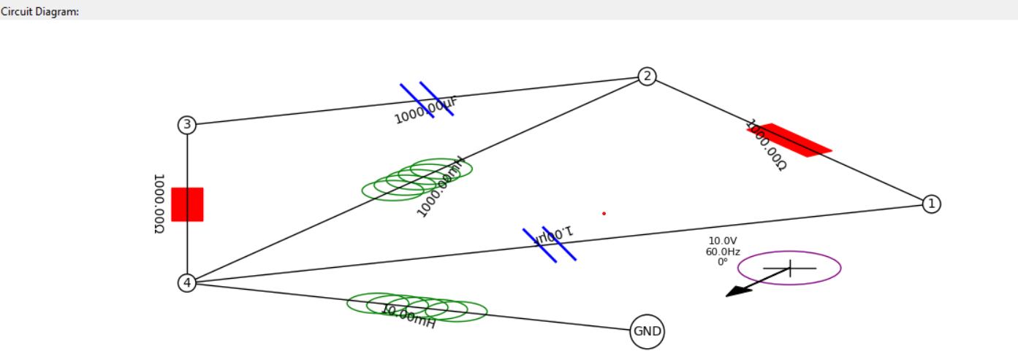
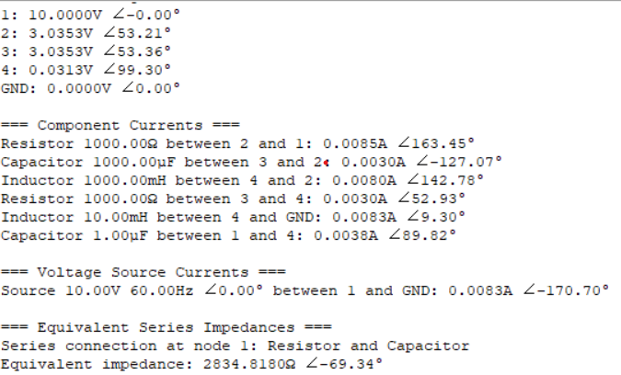
Does It Really Work?

Slide 30



Live Demo
BATTERY
BULB

Slide 31
Limitations & Edge Cases
Singular Matrices:
Floating nodes → No reference voltage.
Fix: Ground a node.
Nonlinear Components:
Diodes/transistors require iterative methods.
Frequency Limitations:
High ω → Numerical instability.

Slide 32


Extensions & Future Work
Live Circuit Simulation
How?
Add a "Play" button to show real-time voltage/current animations
Smart Component Suggestions
How?
Auto-recommend resistor values to hit target voltages
Solving dependent sources
How?
Solve multiloops with dependent sources

Slide 33
Conclusion
Graphs + Matrices = Automated analysis
Try the code! Extend to your favorite circuits

Slide 34

Resource
Page

Slide 35
Thank you

